Slide 1
Population Composition
Population composition refers to the physical, socio-cultural and economic attributes of the population, such as age, sex, place of residence, language, religion, marital status, ethnicity, literacy, education and occupation (CBSC BOOK INDIA)

Slide 2
Age Structure
Age is an important component in demographic structure. Age structure represents the number of people of different age groups. This is an important indicator of population composition,

Slide 3
Because large size of population in the age group of 15- 59 indicates a large working population. A greater proportion of population above 60 years represents an ageing population which requires more expenditure on health care facilities. Similarly high proportion of young population would mean that the region has a high birth rate and the population is youthful.

Slide 4
Most countries of Africa, Asia and Latin America have high birth rate and have large population in lower age group. Likewise low life expectancy leads to less people in older age group
Countries having low birth rate and high life expectancy.

Slide 5
Life Expectancy,2011
USA- 77 Nigeria -55
Japan-85 India 67.13
Switzerland-83.4 Pak-65
Spain- 83 Bangladesh--70
Italy-83.2 china-74
Australia-83.4
Central African Republic-53.3
Chad-53.4
Lesotho- 54

Slide 6
Sex Structure or composition
The number of women and men in a country is an important demographic characteristic. The ratio between the number of women and men in the population is called the Sex Ratio.
In some countries it is calculated by the number of males per thousand females. In India, the sex ratio is worked out by the number of females per thousand males.

Slide 7
The sex ratio of India
In 2020 male 717 million and 663 million female. Find out sex ratio
India sex ratio
927---1991
933—2001
940--2011

Slide 8
The sex ratio is an important information about the status of women in a country. In regions where gender discrimination is rampant, the sex ratio is bound to be unfavourable to women. Such areas are those where the practice of female foeticide, female infanticide and domestic violence against women are prevalent.

Slide 9
One of the reasons could be lower socio-economic status of women in these areas. It is noted that more women in the population does not mean they have a better status. It could be that the men might have migrated to other areas for employment.

Slide 10
Sex Ratio in the world-980/1000
Latvia highest sex ratio- 1176/1000
Qatar- 322/1000
India sex ratio-940/1000
Sex ratio favorable for female in 139 countries/ unfavorable 72

Slide 11
Sex ratio is in favor of females in Europe, North America and Africa
Male outnumbers female in Latin America, Asia and Oceania. China, India, Saudi Arabia,Pakistan, Afghanistan have a lower sex ratio
Europe (including Russia) where a deficit of males in the populations of many European countries is attributed to better status of women, and an excessively male-dominated out-migration to different parts of the world in the past.

Slide 12
Sex ratio is balanced where no discrimination among male and female children and death rate and birth rate are similar
Sex ratio in favour of female—Europe, N.Ameria and Africa
Sex ratio unfavourable to female-Latin America, Asia, Oceania

Slide 13
Age-Sex Pyramid
The age-sex structure of a population refers to the number of females and males in different age groups. A population pyramid is used to show the age-sex structure of the population.
The shape of the population pyramid reflects the characteristics of the population. The left side shows the percentage of males while the right side shows the percentage of women in each age group.

Slide 14
Types of population pyramids
Progressive or Expanding Population: (increasing birth rate and high mortality)
Stationary or constant Population: (unchanging Fertility and Mortality rate over long period of time)
Declining or regressive Population: (low birth rate and low mortality)

Slide 15
Different age-sex pyramid of Nigeria as you can see is a triangular shaped pyramid with a wide base and is typical of less developed countries. These have larger populations in lower age groups due to high birth rates. If you construct the pyramids for Bangladesh and Mexico, it would look the same.

Slide 16
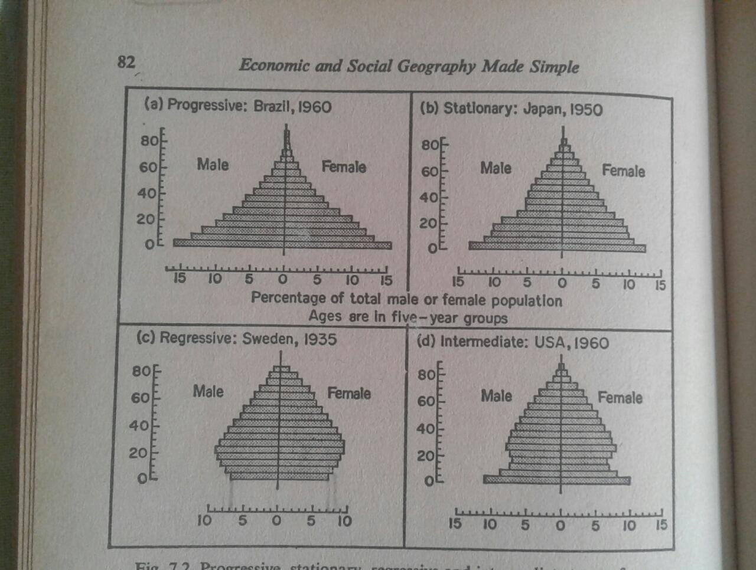

Slide 17
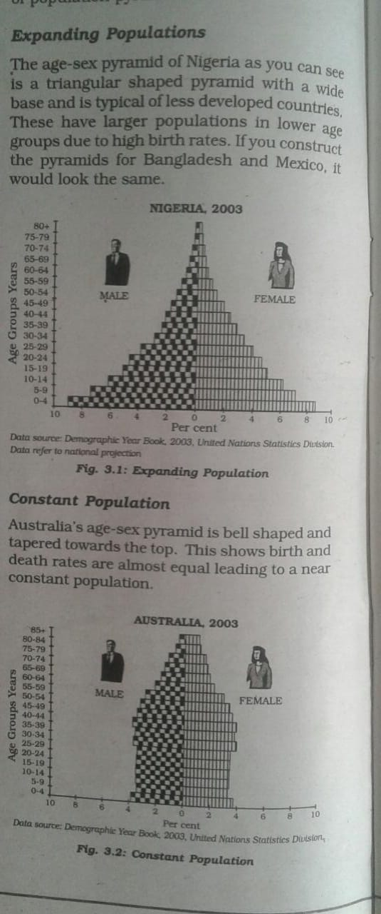

Slide 18
Population Australia’s age-sex pyramid is bell shaped and tapered towards the top. This shows birth and death rates are almost equal leading to a near constant population or stationary.
Declining Populations or Regressive Population The Japan pyramid has a narrow base and a tapered top showing low birth and death rates. The population growth in developed countries is usually zero or negative.

Slide 19
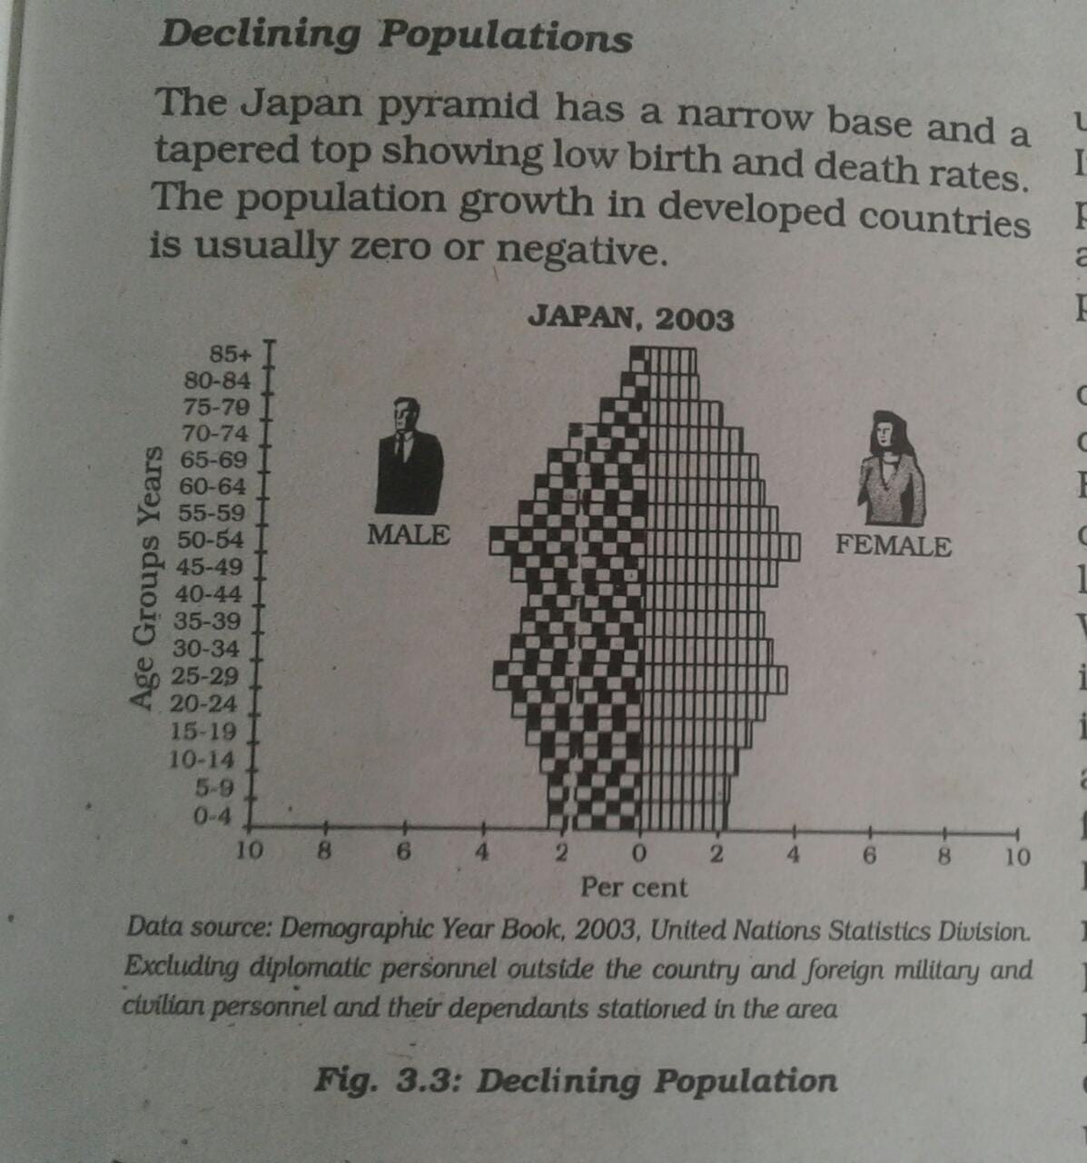

Slide 21
RURAL URBAN COMPOSITION
. The division of population into rural and urban is based on the residence. This division is necessary because rural and urban life styles differ from each other in terms of their livelihood and social conditions. The age-sex-occupational structure, density of population and level of development vary between rural and urban areas.

Slide 22
The criteria for differentiating rural and urban population varies from country to country. In general terms rural areas are those where people are engaged in primary activities and urban areas are those when majority of the working population is engaged in non-primary activities.

Slide 23
The rural and urban differences in sex ratio in Canada and West European countries like Finland are just the opposite of those in African and Asian countries like Zimbabwe and Nepal respectively. In Western countries, males outnumber females in rural areas and females outnumber the males in urban areas. In countries like Nepal, Pakistan and India the case is reverse.

Slide 24
The excess of females in urban areas of U.S.A., Canada and Europe is the result of influx of females from rural areas to avail of the vast job opportunities. Farming in these developed countries is also highly mechanised and remains largely a male occupation. By contrast the sex ratio in Asian urban areas remains male dominated due to the predominance of male migration.

Slide 25
It is also worth noting that in countries like India, female participation in farming activity in rural area is fairly high. Shortage of housing, high cost of living, paucity of job opportunities and lack of security in cities, discourage women to migrate from rural to urban areas.

Slide 26
India’s Rural Urban Sex Ratio
In general more males are born than females
Adverse Sex Ratio
However not adverse everywhere
Rural areas-946/1000males
Urban areas- 901/1000males

Slide 27
In India(74%) – literacy rate denotes the percentage of population above 7 years of age, who is able to read, write and have the ability to do arithmetic calculations with understanding.

Slide 28
Occupational Structure
The working population (i.e. women and men of the age group – 15 to 59) take part in various occupations ranging from agriculture, forestry, fishing, manufacturing construction, commercial transport, services, communication and other unclassified services.

Slide 29
Agriculture, forestry, fishing and mining are classified as primary activities
manufacturing as secondary
transport,communication and other services as tertiary
and the jobs related to research and developing ideas and higher class of services as quaternary and quinary activities.

Slide 30
The proportion
of working population engaged in these five
sectors is a good indicator of the levels of
economic development of a nation. This is
because only a developed economy with
industries and infrastructure can
accommodate more workers in the secondary,
tertiary and quaternary sector.

Slide 31
Developed countries of the world have more percentage of people engaged in secondary,tertiary,quaternary and tertiary activities.

Slide 32
If the economy
is still in the primitive stages, then the
proportion of people engaged in primary
Activities would be high, as it involves extraction
of natural resources. Under developed countries have such scenario

